Slide 1
E-Lemon-ators
Travis Harbaugh, Ben Holmes, Anthony House, Cory Johannes, Jose Lopez, Ryan Quigley
Notes:
http://seniord.ee.iastate.edu/resources/491_Final_Presentation.pdf

Slide 2
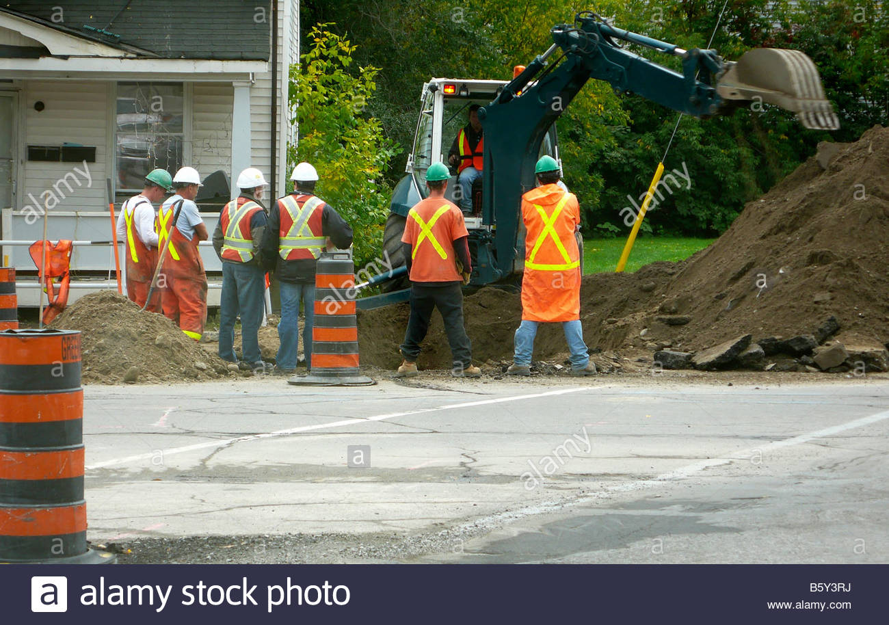
Construction workers standing around
PROBLEM

Slide 3
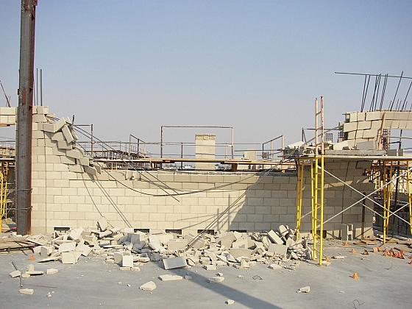
Damage on site. What happened?
PROBLEM

Slide 4
Conceptual Sketch
SOLUTION

Slide 5
Functional Requirements
Indoor user tracking
Software shall track 1 individual in durham
Moving Sensitive
Basic walking and running speeds
Store tracking information in the internal device
Store user location while app is disconnected to WI-FI access point
Distance Accuracy
Track users location within a radius of +/- 1 meter
Notes:
The software shall be able to track up to 1 individual with a separate trajectories within Durham hall.
The software shall track user’s moving at basic walking and running speeds.
The software shall store movement information on the app until it can be sent to a server using Wi-Fi connection.
The software shall track the location of the user within a radius of +/- 1 meter.

Slide 6
Functional Requirements
Delay accuracy
Allow a 5 second delay to run new location data smoothing/prediction algorithm
Tested by attaching a timestamp and comparing it a when it completes execution
Hololens augmented reality
The augmented reality software shall monitor users/vehicles movement within a conference room
It shall display a object new location in real time
Up to 1 minute from when data was captured
Notes:
The software shall allow a 5 second delay to run the data collected through a smoothing/prediction algorithm to produce an estimation and send it to the database. This could be tested by attaching a timestamp to new data and comparing it to when it arrives in the database.
The software shall use the location data stored in the database to monitor construction vehicles/workers movement from within a conference room. It shall display it in augmented reality on the HoloLens within 1 minute from when the data we captured.

Slide 7
Non-functional Requirements
Battery
Run heavy CPU operations
Must last entire work day
GPS sensor
The tracking algorithm shall work without the use of GPS.
Sensor accuracy is not within 1-meter requirement
Unreliable indoors ( Wifi access points)
Notes:
The android application shall run in a background service, and last for an entire work day.

Slide 8
Technical / Other Constraints / Considerations
Phone Position
The phone shall be strapped to the right arm in a horizontal position with the screen facing forward.
Initialization
The users shall calibrate the app prior to entering the environment.
Infrastructure
Placement of Bluetooth Beacons, Access Points, and speakers should be in large open areas, where line of sight is possible.
Notes:
Cory

Slide 9
Market Survey
Our design…
Doesn’t rely on specialized hardware, keeping costs down
Utilizes multiple systems to track
Will incorporate Hololens data visualization
Notes:
Cory

Slide 10
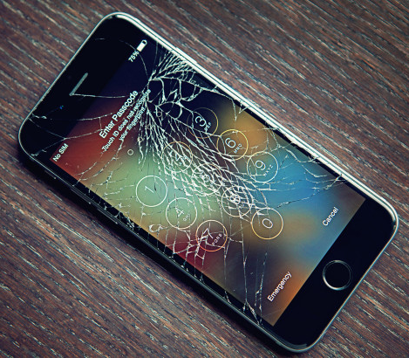
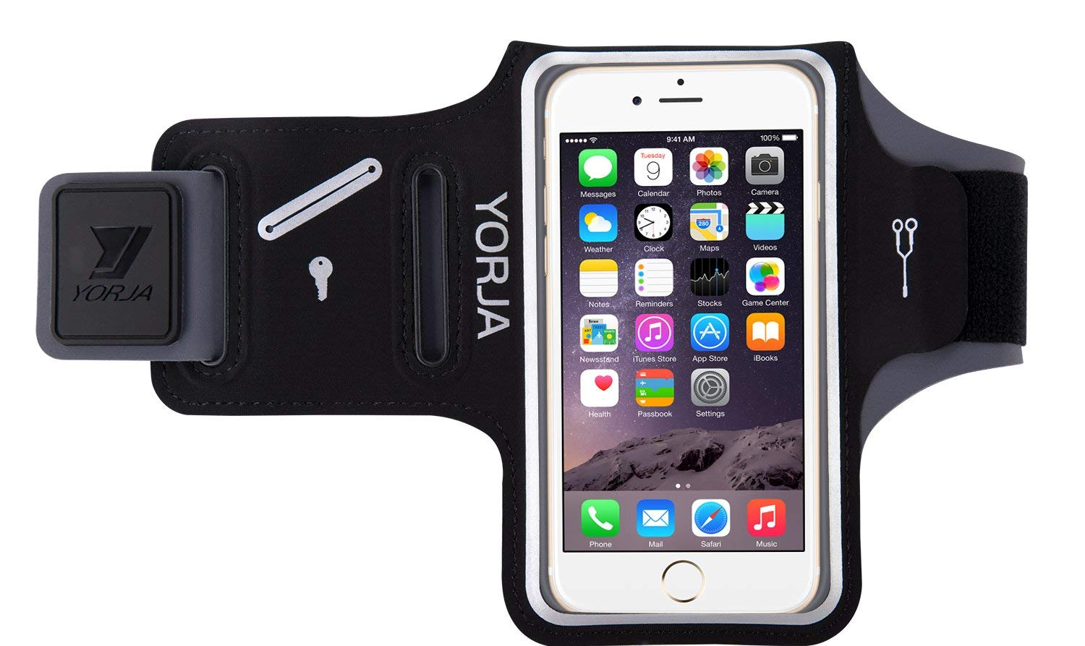
Potential Risks Mitigation
Notes:
Cory

Slide 11
Resource / Cost Estimate
Hololens
Development Edition: $3000
Smart phone
$200-300 for reasonable model
Server Hosting
$10/month
Access Points
~$30 each
Notes:
Cory

Slide 12
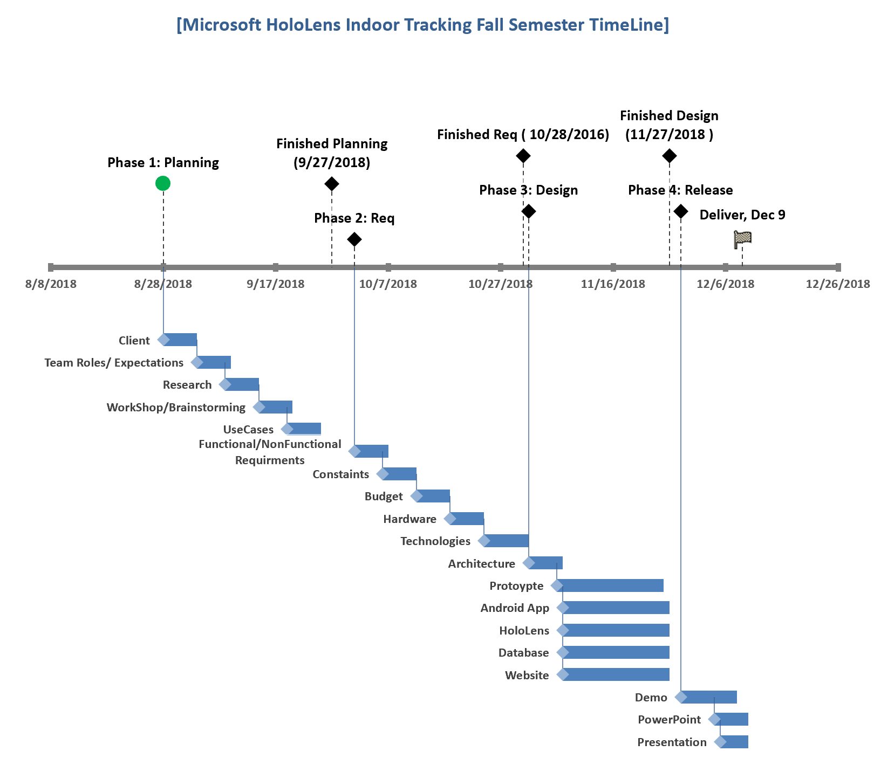
SCHEDULE
Fall 2018

Slide 13
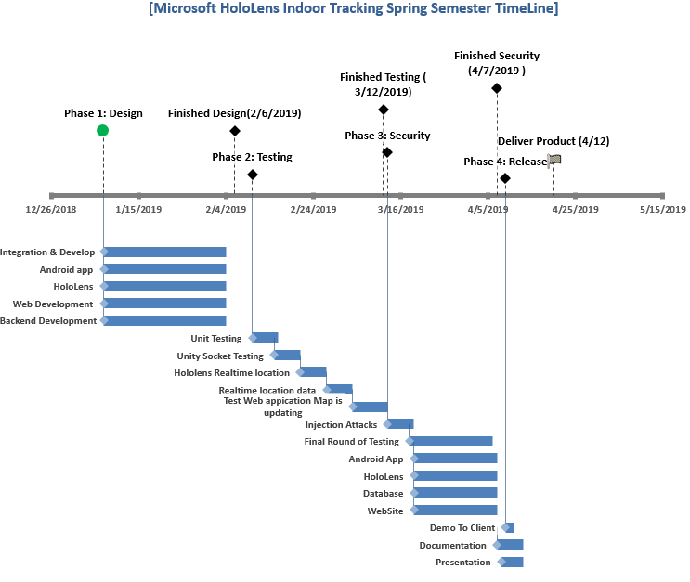
SCHEDULE
Spring 2019

Slide 14
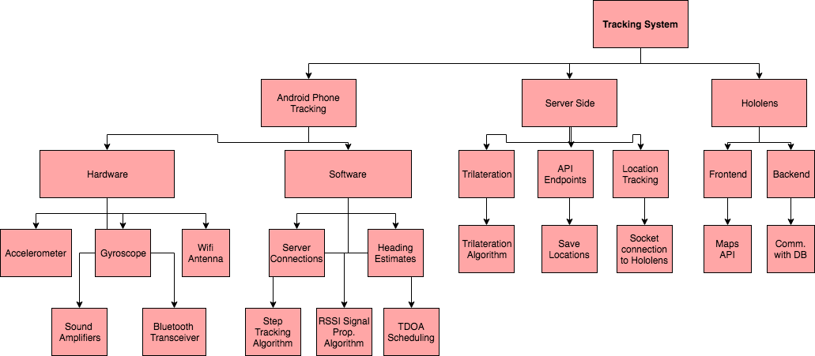
Functional Decomposition

Slide 15
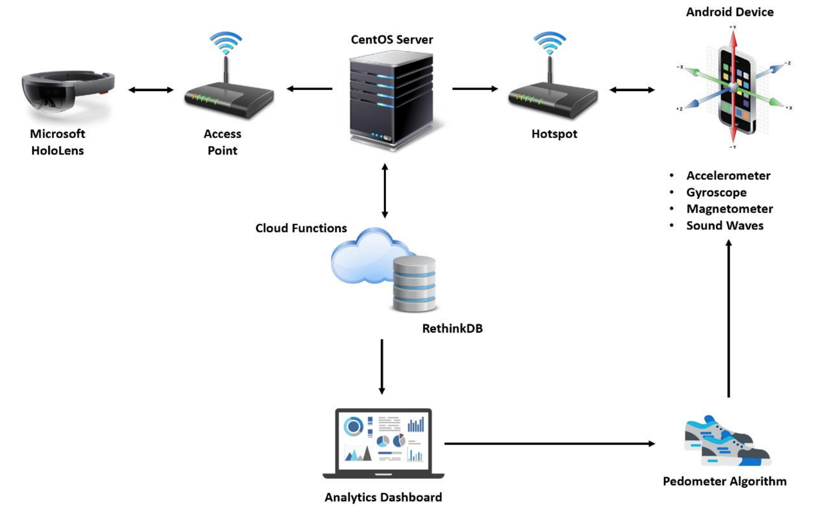
Detailed Design Architecture (Next 3 Slides)

Slide 16
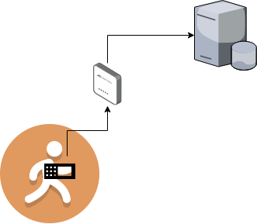
PDR System Architecture
Step Tracking Algorithm
if(not recording step &&
acceleration above threshold){
//begin recording for current step
}
else if(recording step &&
acceleration below threshold){
//finish step
Add step length relative to peak acceleration.
Send step to database with heading.
Reset to track next step.
}
if(recording step){
//record peak acceleration.
}

Slide 17
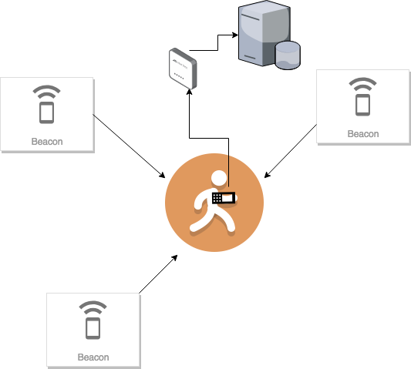
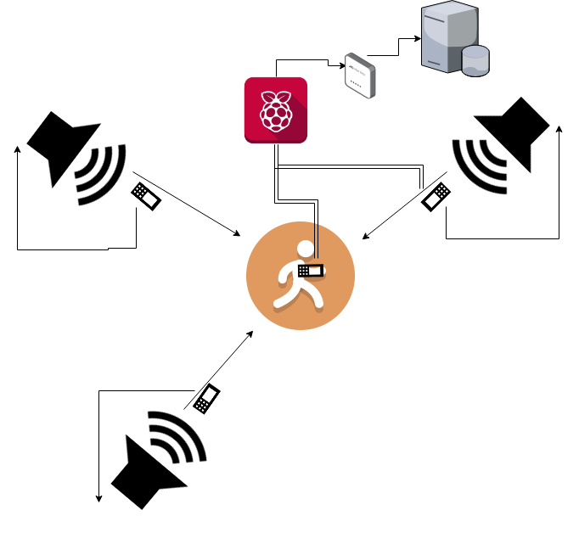
TDOA Trilateration
RSSI Trilateration (Distance algorithm next slide)

Slide 18
RSSI Distance Estimation Algorithm
Note: This algorithm was developed by AltBeacon. We are using one of their beacons in our project, so we are also testing their signal propagation time equation.
calculateDistance(int txPower, double rssi)
if(rssi == 0)
return -1
ratio = rssi * 1.0/txpower
if(ratio < 1.0)
return ratio^10
else
accuracy = (0.89976)*(ratio^7.0795) + 0.111
return accuracy

Slide 19
HW/SW/Technology Platforms Used
Android Specific Hardware
Accelerometer [1]
Piezoelectric
Gyroscope [2]
Tuning Fork/Hemisphere
Spinning wheel (in vacuum)
Bluetooth Transceiver
Wifi Antenna
Trilateration Hardware
Bluetooth Transceiver
Bluetooth Beacons
Wifi Antenna
Wireless Access Points
Sound Amplifiers
Ability to transmit a frequency of 16,000hz 20 meters (line of sight)
Software
Android SDK, Raspbian, NodeJS, MongoDB

Slide 20
Test Plan
Path Tracking
Setup 3 android devices at different starting locations
Provide specific paths to walk (starting point and ending point)
Compare test path with actual path
Movement Sensitivity
Turn on mobile application
Perform walking and running movements
Data Storage
Connect to WiFi hotspot
Perform Http request and verify it successfully saved in the database
Distance Accuracy
Give a user a new starting location
Instruct him/her to move 1 meter and verify the new location is within 1 meter requirement
Delay Accuracy
Gather all sensor readings , create a timestamp, perform smoothing/prediction algorithm, compare with new timestamp after completion .
Notes:
We will setup 3 Android devices at different starting locations. We will provide the user with a specific path to walk which includes a start point and an endpoint. We will then record their path and display it on Mapbox, comparing the accuracy of our prediction estimates to the true path.
We will turn on the mobile application and then have the user perform normal walking and running movements.
We will connect the mobile device to WiFi and will then perform HTTP requests to save data in our database.
We will give a user a new starting location to start the application at. We will instruct him/her to move 1 meter and see if the new predicted location is within a meter.
We will use a timestamp when the mobile application has gathered all the sensor data and starts to perform the smoothing/prediction algorithm while the software creates a 5 second delay. After the delay is completed the software will create another timestamp and compute the difference.

Slide 21
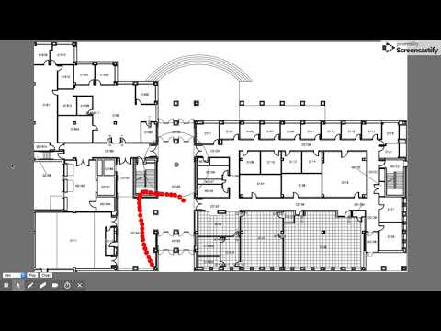
Prototype Implementations
Notes:
https://youtu.be/gmaWt9bRz0w

Slide 22
Project Status Relative to Milestones
Android App
Functions with PDR system, but is lacking trilateration implementations
Server Backend
Working, with API endpoints for realtime app to server display
Server Frontend (Website)
Basic/bland visual display, but functions as required
Demo
Presented today, still lacking trilateration aspects
Notes:
Phone collecting sensor data and using Pedestrian Dead Reckoning working with the Android app.
Plans to implement trilateration for next semester.
The server is hosted by ISU and the backend is using Mean Stack(MongoDB, Express engine, Angular, Node) without Angular.
The frontend is a JS canvas with simple shapes representing beacons and the user.
Demo showing the prototype.

Slide 23
Task Responsibility
Ben
Implement TDOA in Android app
TDOA trilateration estimates in Android app
Travis
Everything Hololens related
Team management
Anthony
API endpoint development
Database Admin
Server Admin
Ryan
Move from the Android Rotation Vector implementation to Gyroscope rotation estimates in Android app
Implement AltBeacon algorithm in app
Jose
Add frontend trilateration visualizations
Implement Trilateration estimations on front-end
Cory
Assist front-end team in Trilateration
Front-End Design

Slide 24
Plan For Next Semester
Implement Time Dilation of Arrival (TDOA)
Implement Trilateration in 2 ways:
TDOA based
RSSI based
Incorporate Hololens functionality
Refine Durham map image to pixel scaling
Replace Android Rotation Vector orientation estimation with Gyroscope

Slide 25
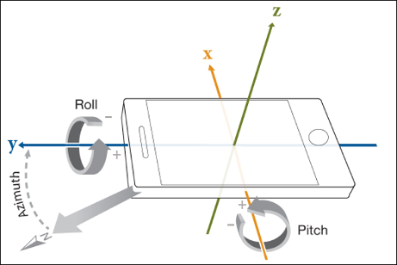
References
[1] Accelerometer:
Piezoelectric crystals sit in 3 perpendicular
axis’ pointing (x,y,z).
[2] Gyroscope:
Tuning Fork/Hemisphere:
Measure the change between two points directly aligned in a given axis.
Spinning wheel(in vacuum):
Frictionless wheel sits inside a vacuum chamber, and is given an electric
charge every given interval. By measuring its change in rotation, you can
determine the rotational velocity.

